Slide 1
Protein Synthesis Review

Slide 2
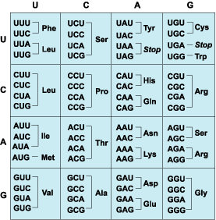
What Chain of nucleotides do you use the Codon chart for?
mRNA

Slide 3
What are the building Blocks of Proteins?
Amino Acids!

Slide 4
What process converts DNA to mRNA?
Transcription

Slide 5
What is translation?
Assembling the Amino Acids by reading mRNA and using tRNA.

Slide 6
What Amino Acids does the following Code for? GTA- CCT-AAA
Histidine
Glycine
Phenylalanine

Slide 7
What is a catalyst?
Anything that speeds up a chemical reaction

Slide 8
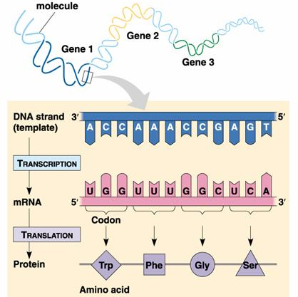
What process is seen in the picture?
Transcription

Slide 9
What does the “R” in “R”RNA stand for?
Ribosomal!

Slide 10
Where are ribosomes located?
Free floating in the cytoplasm or on the rough endoplasmic reticulum

Slide 11
What process is seen in the picture?
Translation!

Slide 12
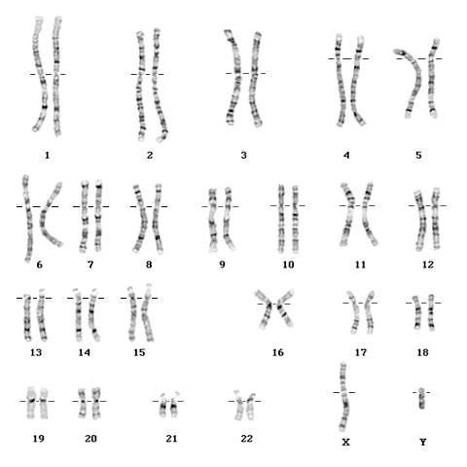
Is the person to the left a boy or a girl?
Boy

Slide 13
What is a codon?
Group of 3 mRNA nucleotides

Slide 14
What are RNA and DNA made out of?
Nucleotides!

Slide 15
What does the “R” in “R”RNA stand for?
Ribosomal!

Slide 16
What are nucleotides made of?
Sugar
Phosphate
Base

Slide 17
Name 3 differences between DNA and RNA.
Ribose vs. Deoxyribose sugar
Uracil instead of Thymine
Single strand Vs. Double Helix

Slide 18
What is a substitution?
One nucleotide base is switched out!

Slide 19
Original DNA: GGG CTA AAT What type of mutation is the following? GGC GCT AAA T
Insertion!

Slide 20
What are enzymes?
Proteins that are catalysts

Slide 21
What are the types of frame shift mutations?
Insertion or deletion!

Slide 22
What does a frame shift mutation cause?
All Codons to be changed due to a shift in the nucleotide bases

Slide 23
What do ribosomes do?
Make Protein!

Slide 24
What is translocation?
Chromosomal Mutation where part of a chromosome as moved to a different chromosome!

Slide 25
What is the tRNA compliment of the following? GGUCCAUG?
CCAGGUAC!

Slide 26
Enzymes work best at HIGH temps. True or False?
False, all enzymes work best at specific temperatures!

Slide 27
What is a lock and key?
How an enzyme binds with a substrate or reactant!

Slide 28
Are the reactants on the left or right of a chemical equation?
Left!
R → P

Slide 29
What is the mRNA code for the following? Methionine- Lysine
AUG-AAA
Or
AUG- AAG!

Slide 30
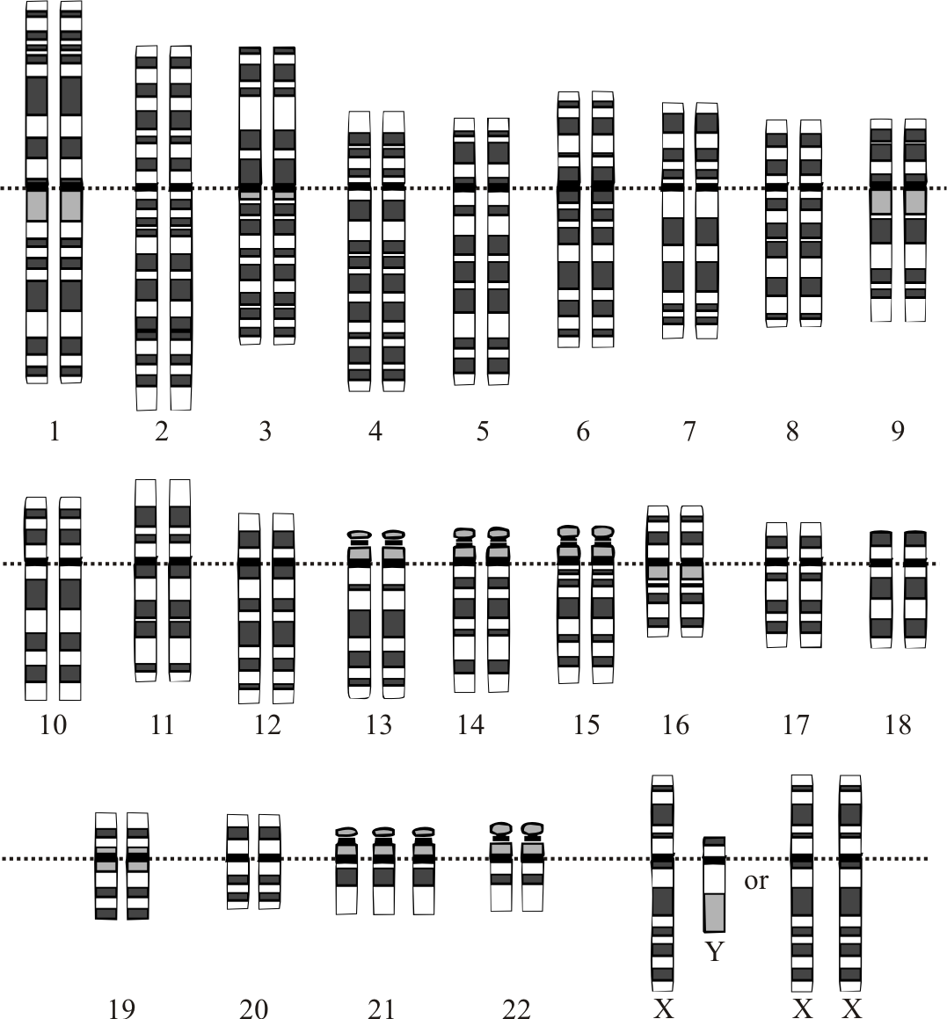
What type of chromosomal mutation is shown here?
Trisomy or Duplication

Slide 31
Where does a mutation have to occur to be passed to offspring?
Gametes!

Slide 32
What is the DNA code for the following? Methionine- Lysine
TAC-TTT
Or
TAC- TTC!

Slide 33
Which type of mutation is most likely to result in death?
Chromosomal!

Slide 34
Original DNA: GGG CTA AAT What type of mutation is the following? GGC CTA AAT
Substitution!

Slide 35
What types of RNA are used in protein synthesis?
mRNA, rRNA, and tRNA!
All of them!

