Slide 1
FUNGUS REVIEW
One Questions Answered
=
One Starburst Eaten!

Slide 2
What is the Part of the fungus that is under the ground called?
Mycelium

Slide 3
Define Decomposer.
Organism that breaks down Organic and inorganic compounds usable by plants

Slide 4
What are hyphae?
Long filaments that make up the body of a fungus

Slide 5
How do stinkhorn fungi spread their spores?
Flies…
because of the smell!

Slide 6
What is the reproductive structure of a fungus?
MUSHROOM

Slide 7
Why do the fruiting bodies appear above ground?
So Spores can be dispersed.

Slide 8
What is the only unicellular Fungi?
YEAST!

Slide 9
How do fungus reproduce?
Sexually and Asexually

Slide 10
What are saprobes?
Decomposers!

Slide 11
What two organisms are lichen?
Fungus and photosynthetic organisms
(algae or cyanobacteria)

Slide 12
What type of symbiosis
do lichens show?
Mutualism!!

Slide 13
What are specialized tissue?
Group of cells that have a specific function.

Slide 14
What is the name of the bread mold?!
GREEN GRAPE JELLY?
RHIZOPUS!!

Slide 15
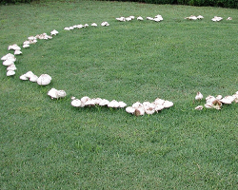
Why do mushrooms only sprout in a ring at the outer edges?
Nutrients have depleted in the middle

Slide 16
Give two major characteristics of fungus.
Eukaryotes
Heterotrophs
Decomposers
Multicellular

Slide 17
Give two examples of fungus negatively effecting people.
Athletes Foot, ring worm, and Thrush

Slide 18
What is an environment with no oxygen?
Anaerobic

Slide 19
Fungi in anaerobic conditions perform what process ?
Fermentation

Slide 20
What gets released from puff balls?
SPORES

Slide 21
What causes Thrush?
Overuse of antibiotics

Slide 22
What percentage of energy is transferred to the green fish?
1 %

Slide 23
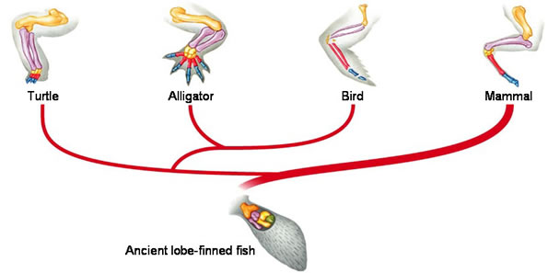
Are these structures homologous or analogous?
homologous

Slide 24
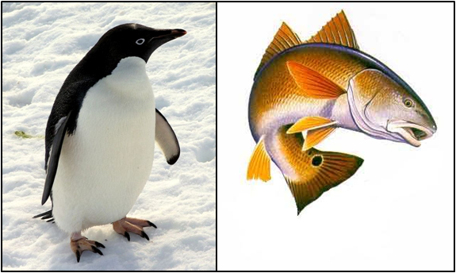
What are analogous structures?
Structures with same function but different structure

Slide 25
What type of symmetry do I have?
Bilateral Symmetry
“EXCELLENT!!”

Slide 26
What is this group of organisms?
POPULATION!

Slide 27
A flexible supporting structure that turns into this dude’s neck/back is a
?
Notocord

Slide 28
What is a body cavity completely lined with a mesoderm?
Coelom

